Slide 1
2020 AAS/AIAA Astrodynamics Specialist Conference August 9-12 2020, South Lake Tahoe
A multirate variational approach to simulation and optimal control for flexible spacecraft
Yana Lishkova , DPhil Candidate* Prof. Sina Ober-Blöbaum § Prof. Mark Cannon* Prof. Sigrid Leyendecker ‡
* Department of Engineering Science, University of Oxford
§ Department of Mathematics, University of Paderborn
‡ Chair of Applied Dynamics, University of Erlangen-Nuremberg

Slide 2
Outline
Short overview
Mathematical model
Multirate DMOC
Computational results and discussion
1

Slide 3
Overview
Flexible spacecraft
Stringent performance and positioning requirements
Efficient operation
Lightweight structure designs and induced vibrations- potentially degrading the performance, causing loss of pointing accuracy or even structural damage
-> Need for efficient control method maximizing the system’s performance while respecting all hard safety-critical constraints
Multirate Discrete Mechanics and Optimal Control (Multirate DMOC) ¹⁻⁴ :
High fidelity simulation at a reduced computational cost
2

Slide 4
Advantages
Multirate Discrete Mechanics and Optimal Control (Multirate DMOC):
High fidelity simulation at a reduced computational cost
Structure-preserving -> conservation of energy and/or momenta of the system
Standard direct methods
DMOC
Lagrangian +
Virtual work
Lagrangian +
Virtual work
Lagrange-d’Alembert principle
DISCRETE Lagrange-d’Alembert principle
Equations of motion
Discrete equations of motion
discretize
Discrete equations of motion
3

Slide 5
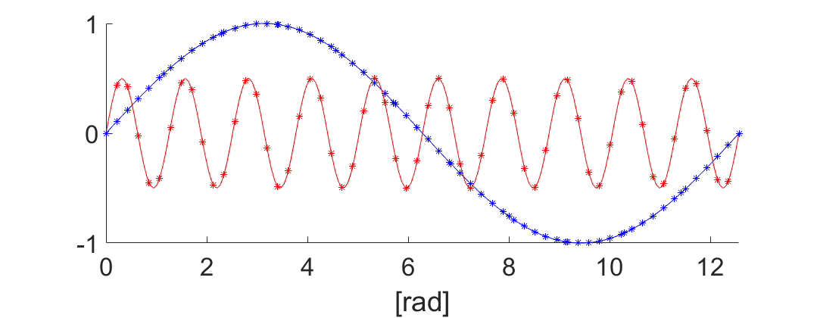
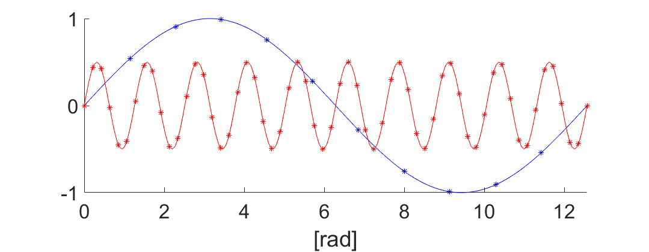
Advantages
Multirate Discrete Mechanics and Optimal Control (Multirate DMOC):
High fidelity simulation at a reduced computational cost
Structure-preserving -> conservation of energy and/or momenta of the system
Multirate discretization -> computational efficiency ⁵
system dynamics
slow subsystem
fast subsystem
Reduces the number of optimization variables
Reduces the number of equality constraints
4

Slide 6
Advantages
Multirate Discrete Mechanics and Optimal Control (Multirate DMOC):
High fidelity simulation at a reduced computational cost
Structure-preserving -> conservation of energy and/or momenta of the system
Multirate discretization -> computational efficiency
Unified control methodology -> potential improvement in optimality and constraint- handling capabilities*
*For comparison see: M. Azadi, M. Eghtesad, S. Fazelzadeh, and E. Azadi, “Dynamics and control of a smart flexible satellite moving in an orbit,” Multibody System Dynamics, Vol. 35, No. 1, 2015, pp. 1–23.
5

Slide 7
Advantages
Multirate Discrete Mechanics and Optimal Control (Multirate DMOC):
High fidelity simulation at a reduced computational cost
Structure-preserving -> conservation of energy and/or momenta of the system
Multirate discretization -> computational efficiency
Unified control methodology -> potential improvement in optimality and constraint- handling capabilities*
No need for decoupling of the equations of motion -> simple application to a variety of linear and nonlinear models*
*For comparison see: M. Azadi, M. Eghtesad, S. Fazelzadeh, and E. Azadi, “Dynamics and control of a smart flexible satellite moving in an orbit,” Multibody System Dynamics, Vol. 35, No. 1, 2015, pp. 1–23.
6

Slide 8
Advantages
Multirate Discrete Mechanics and Optimal Control (Multirate DMOC):
High fidelity simulation at a reduced computational cost
Structure-preserving -> conservation of energy and/or momenta of the system
Multirate discretization -> computational efficiency
Unified control methodology -> potential improvement in optimality and constraint- handling capabilities*
No need for decoupling of the equations of motion -> simple application to a variety of linear and nonlinear models*
Straightforward selection of slow and fast subsystems -> capability to tailor the solution to the time scales present in the problem to obtain further reductions in computational cost*
*For comparison see: M. Azadi, M. Eghtesad, S. Fazelzadeh, and E. Azadi, “Dynamics and control of a smart flexible satellite moving in an orbit,” Multibody System Dynamics, Vol. 35, No. 1, 2015, pp. 1–23.
7

Slide 9
Advantages
Multirate Discrete Mechanics and Optimal Control (Multirate DMOC):
High fidelity simulation at a reduced computational cost
Structure-preserving -> conservation of energy and/or momenta of the system
Multirate discretization -> computational efficiency
Unified control methodology -> potential improvement in optimality and constraint- handling capabilities
No need for decoupling of the equations of motion -> simple application to a variety of linear and nonlinear models
Straightforward selection of slow and fast subsystems -> capability to tailor the solution to the time scales present in the problem to obtain further reductions in computational cost
7

Slide 10

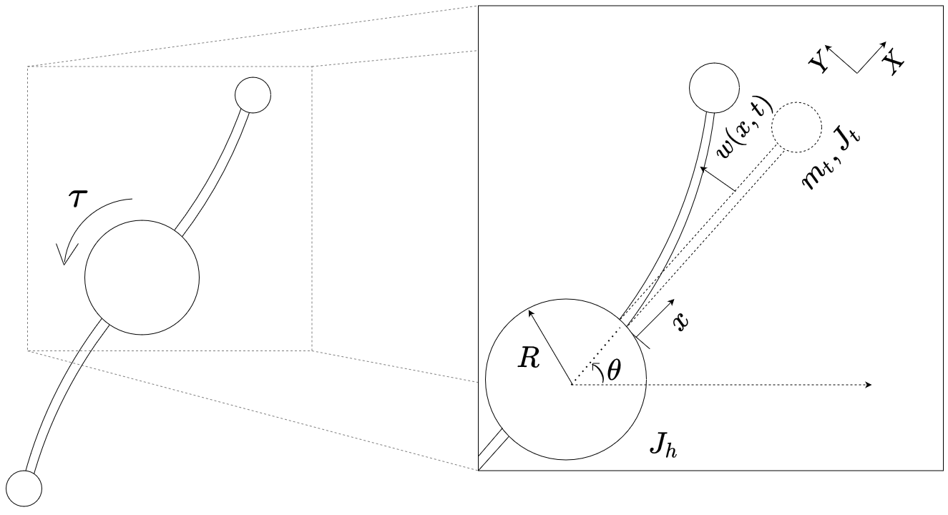
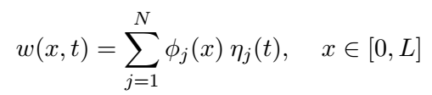
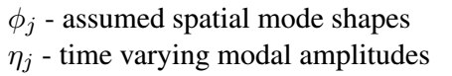
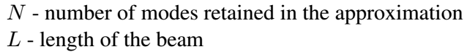
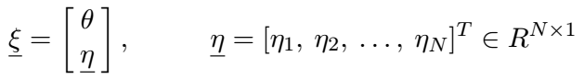
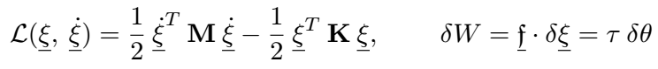
Mathematical model
General linear model neglecting dissipation effects - single-axis rest-to-rest rotational maneuver - control torque applied at the hub
Spatial discretization - The Assumed Modes Method ⁷
System description ⁷
- Lagrange - d’Alembert principle
8

Slide 11
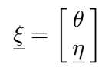
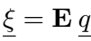
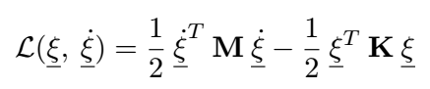
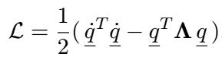
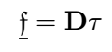
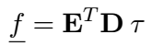
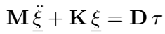
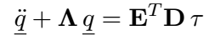
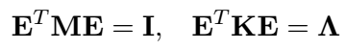
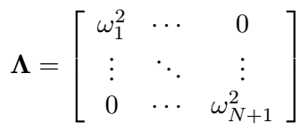
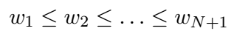
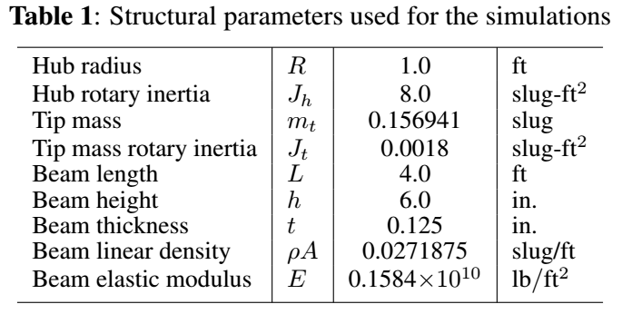
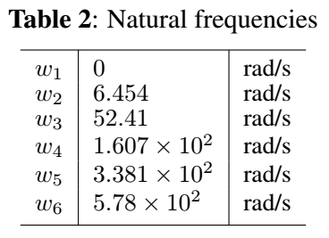
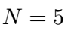
Transformation to modal coordinates
transformation to modal coordinates ⁷
9

Slide 12
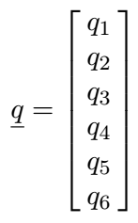
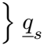
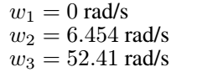
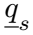
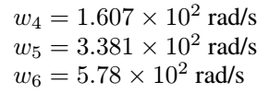
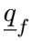
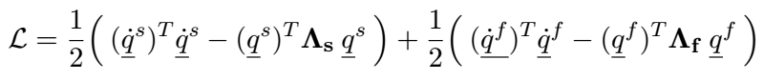
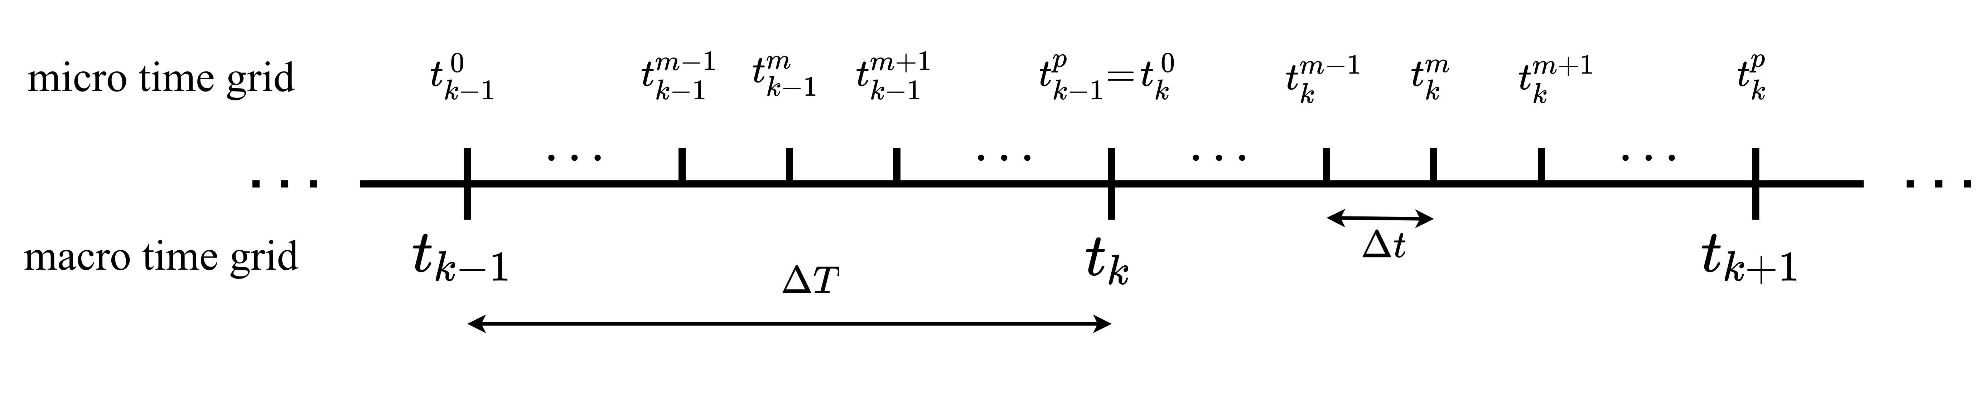
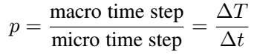
Multirate formulation
10

Slide 13
Multirate formulation
Discrete approximation of the Lagrangian
Discrete Lagrange-d’Alembert principle
Discrete equations of motion
Discrete approximation of the virtual work
11

Slide 14
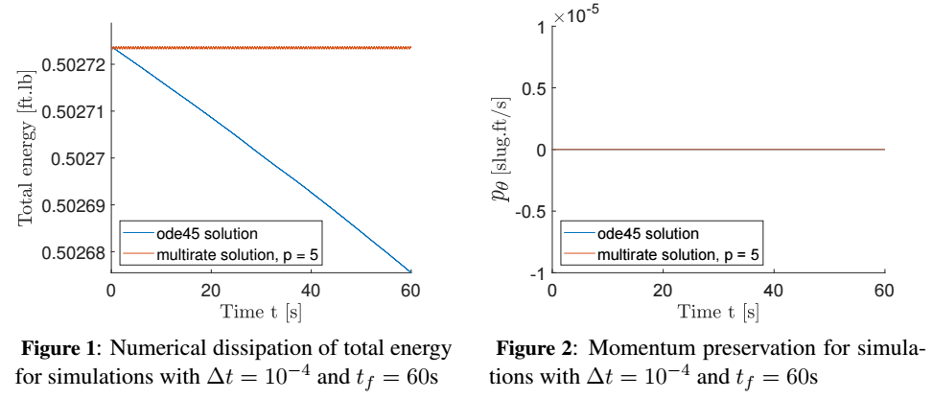
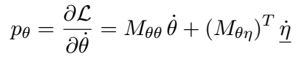
Forward simulation without control
12

Slide 15
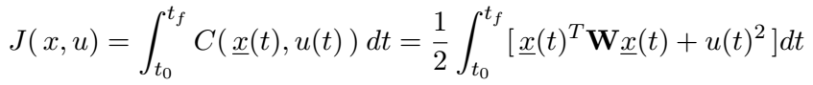
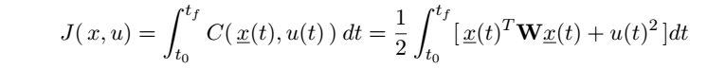
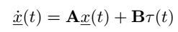
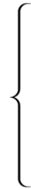
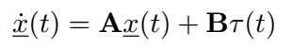
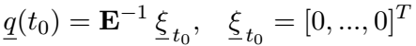
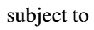
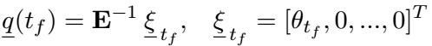
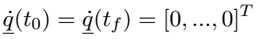
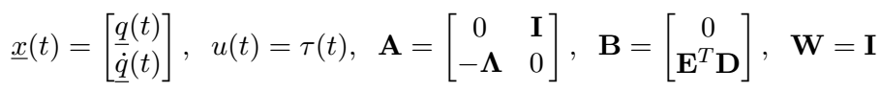
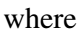
Optimal control problem formulation
13

Slide 16
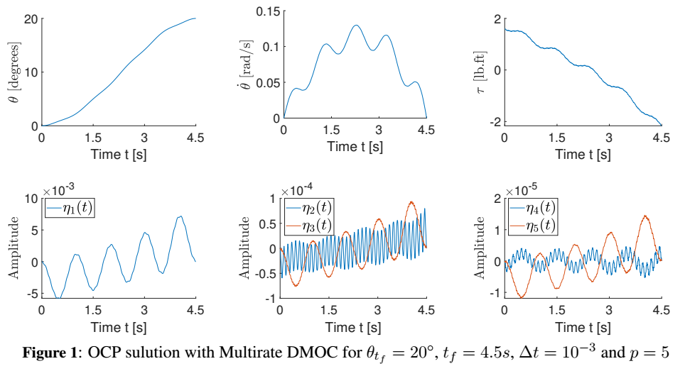
Example solution
14

Slide 17
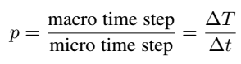
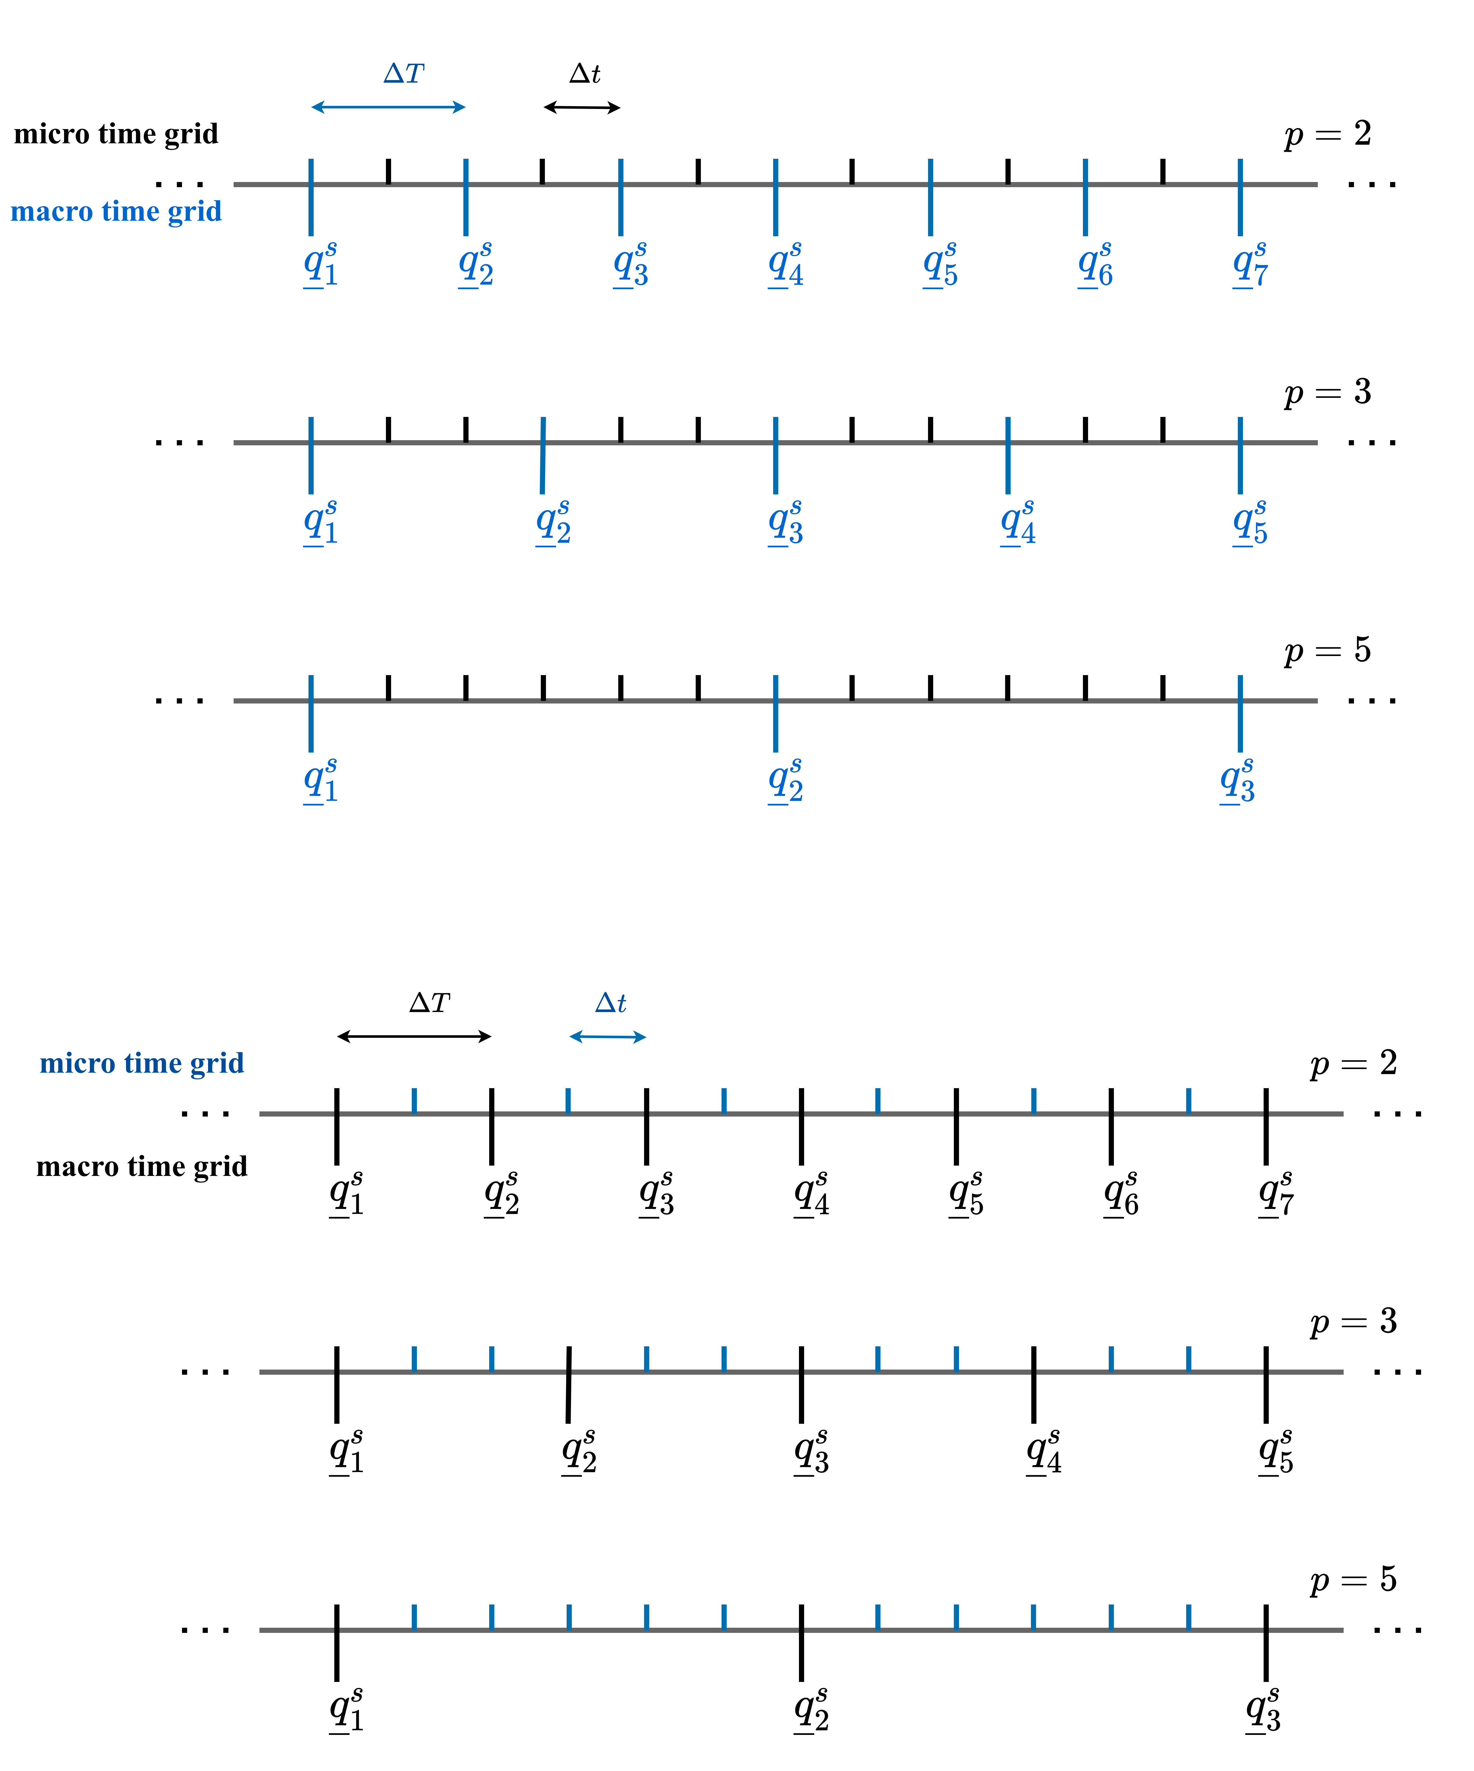
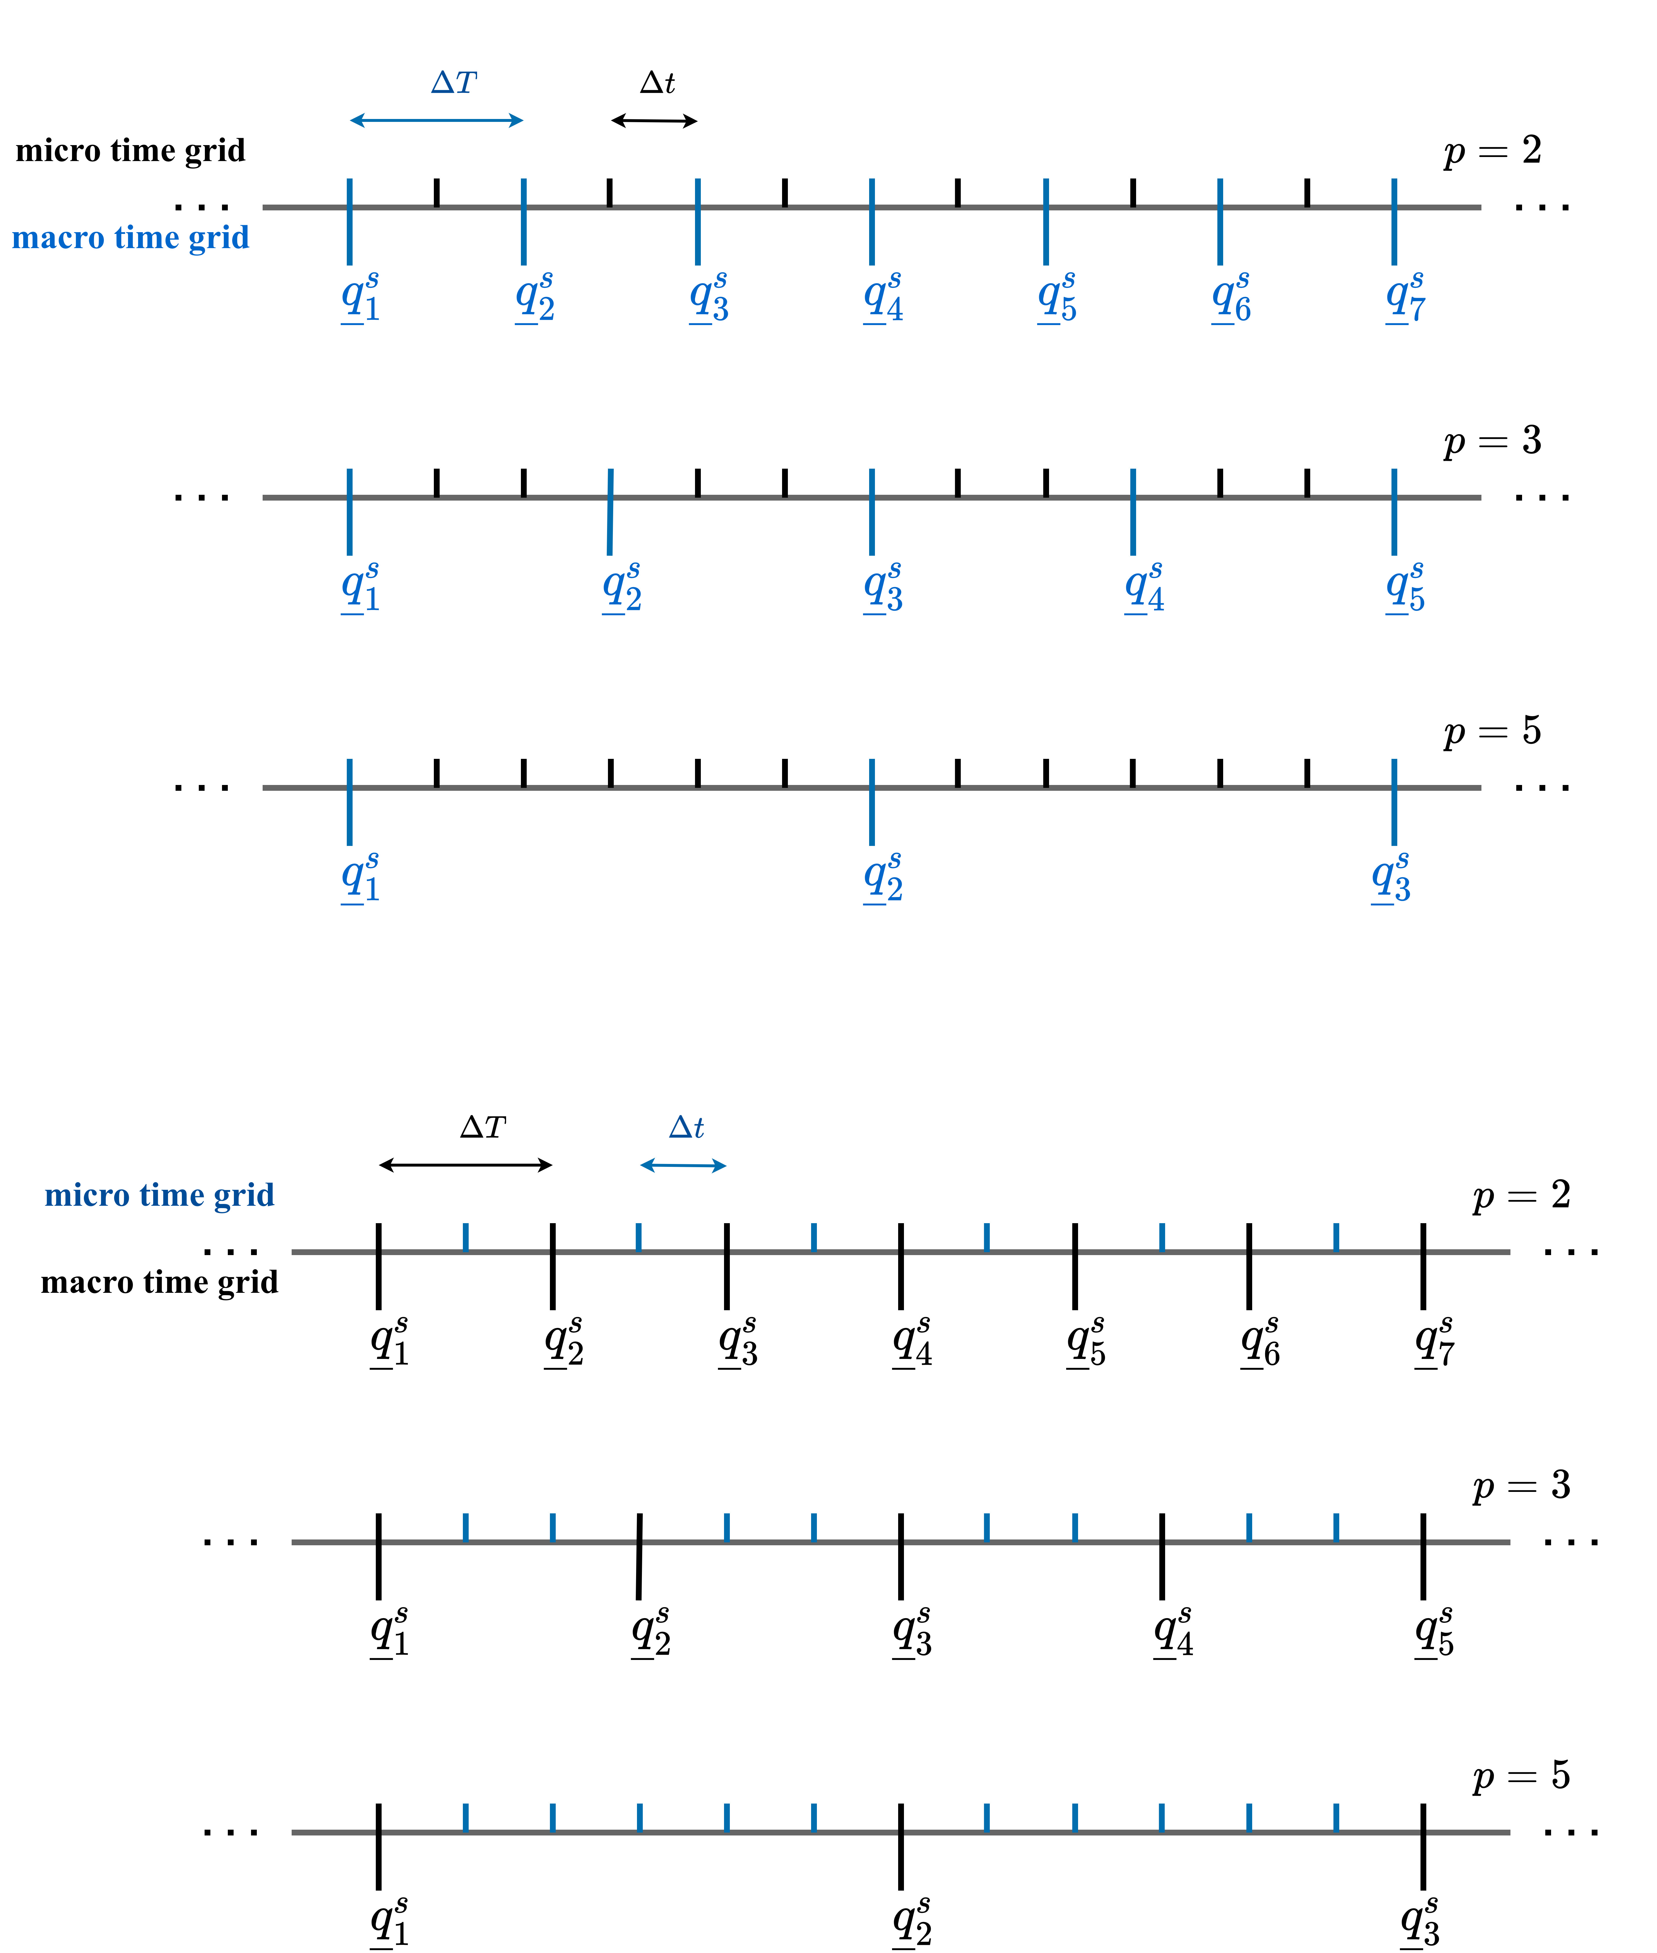
Problem size
15

Slide 18
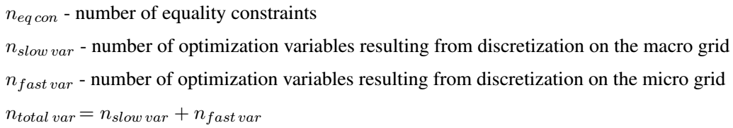
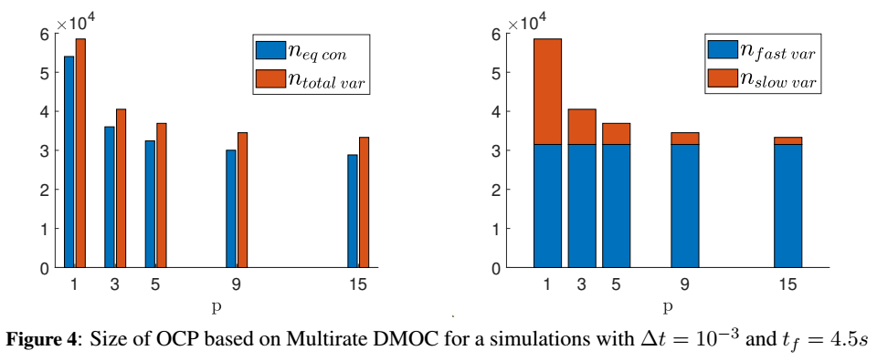
Problem size
16

Slide 19



Main result- the trade-off
17

Slide 20
Main result- the trade-off
7.631
3.286
9.6e-06
1.5e-05
18

Slide 21




Further customization
19

Slide 22
Conclusions
Multirate Discrete Mechanics and Optimal Control (Multirate DMOC):
High fidelity simulation at a reduced computational cost
Structure-preserving -> conservation of energy and/or momenta of the system
Multirate discretization -> computational efficiency
Unified control methodology -> potential improvement in optimality and constraint- handling capabilities
No need for decoupling of the equations of motion -> simple application to a variety of linear and nonlinear models
Straightforward selection of slow and fast subsystems -> capability to tailor the solution to the time scales present in the problem to obtain further reductions in computational cost
Flexibility to tailor the method to the time scales of the problem and obtain the required fidelity at a reduced computational cost!
Future work – methods for obtaining optimal p and r and extending the work to models including kinematic nonlinearities and dissipation effects
20

Slide 23
THANK YOU FOR YOUR ATTENTION!
Contact details:
Yana Lishkova, yana.lishkova@eng.ox.ac.uk Address: St. Edmund Hall, Queen’s Lane, OX1 4AR, United Kingdom
Main references:
[1] T. Gail, S. Ober-Blöbaum, and S. Leyendecker, “Variational multirate integration in discrete mechanics
and optimal control,” Proceedings of ECCOMAS, 2017, pp. 1–4.
[2] O. Junge, J. E. Marsden, and S. Ober-Blöbaum, “Discrete mechanics and optimal control,” IFAC
Proceedings Volumes, Vol. 38, No. 1, 2005, pp. 538–543.
[3] S. Ober-Blöbaum, O. Junge, and J. E. Marsden, “Discrete mechanics and optimal control: an analysis,”
ESAIM: Control, Optimisation and Calculus of Variations, Vol. 17, No. 2, 2011, pp. 322–352.
[4] S. Leyendecker and S. Ober-Blöbaum, “A Variational Approach to Multirate Integration for Constrained
Systems,” Multibody Dynamics: Computational Methods and Applications (J.-C. Samin and P. Fisette,
eds.), pp. 97–121, Dordrecht: Springer Netherlands, 2013
[5] T. Gail, S. Leyendecker, and S. Ober-Blöbaum, “Computing time investigations of variational multirate
integrators,” ECCOMAS Multibody Dynamics, 2013.
[6] M. Azadi, M. Eghtesad, S. Fazelzadeh, and E. Azadi, “Dynamics and control of a smart flexible satellite
moving in an orbit,” Multibody System Dynamics, Vol. 35, No. 1, 2015, pp. 1–23.
[7] J. L. Junkins and Y. Kim, Introduction to dynamics and control of flexible structures. American Institute
of Aeronautics and Astronautics, 1993.

